Slide 1

Super Cipher Cryptography System Based on
Vigenere Cipher and Polybius Cipher
By
THONDALADINNE TARUN KUMAR (21BF1A3754)
KANNEPPAGARI YOGANANDHA (21BF1A3732)
BURUJU ANYALA (21BF1A3710)
PULAGALLA SRIHARI (21BF1A3749)
Under the guidance of
Mrs. A. Ashasharmani(Ph.D)
DEPARTMENT OF COMPUTER SCIENCE AND ENGINEERING (CYBER SECURITY)
SRI VENKATESWARA COLLEGE OF ENGINEERING
(Autonomous)
Karakambadi Road, Tirupati-517507
2021-2025

Slide 2
OUTLINE
ABSTRACT
INTRODUCTION
PROBLEM STATEMENT
EXISTING SYSTEM
DISADVANTAGES
PROPOSED SYSTEM
ADVANTAGES
ARCHITECTURE
WORKFLOW
SYSTEM ARCHITECTURE
HARDWARE REQUIREMENTS
SOFTWARE REQUIREMENTS
UML DIAGRAMS
MODULES
CODING
TESTING
EXECUTION
SCREENSHOTS
CONCLUSION
REFERENCES

Slide 3
ABSTRACT
Secure Communication of message from sender to receiver is one of the main security concern of Internet users across world. It is because of the regular attacks and threats and most Important Data Privacy. In order to sort out these issues, we use cryptographic algorithm which encrypts data in some cipher and transfers it over the internet and again decrypted to original data.
Thus, lightweight cryptography methods are proposed to overcome many of the problems of conventional cryptography Ciphers act as encapsulating system for message. Hybrid Algorithm will be formed from use of different types of ciphers.
The cryptosystem performs its encryption by encrypting the plaintext using Vigenere Cipher and further again processing though Polybius Cipher.

Slide 4
INTRODUCTION
Cryptography Definition
Cryptography is the science of protecting information by transforming it into a secure format. This process, called encryption, has been used for centuries to prevent handwritten messages from being read by unintended recipients.
Today, cryptography is used to protect digital data. It is a division of computer science that focuses on transforming data into formats that cannot be recognized by unauthorized users.
Two Types of Cryptography:
Symmetric Cryptography
Asymmetric Cryptography

Slide 5
PROBLEM STATEMENT
This project is all about creating a better solution for encryption by developing a Super Cipher Cryptography System that combines two methods: the Vigenère Cipher and the Polybius Cipher. The Vigenère Cipher offers a clever way to encrypt messages by using a series of different alphabets, which makes it harder for attackers to decipher. However, it has its flaws, especially when short keys are used, making it easier for determined to break the code. On the other hand, the Polybius Cipher uses a simple grid to encode letters, which is easy to understand but can be cracked if someone knows the grid pattern..

Slide 6
EXISTING SYSTEM
Existing system is based on individual algorithms like the Vigenere Cipher or the Polybius Cipher for encrypting data. The Vigenere Cipher, known for its use of a key to create a polyalphabetic substitution pattern, adds a layer of complexity to basic ciphers.
It can still be cracked using techniques like frequency analysis or key guessing, especially when the key is predictable or short. Meanwhile, the Polybius Cipher works by using a simple grid system to substitute letters with pairs of coordinates. Although easy to implement, it offers limited security in today’s world of advanced cyber threats.

Slide 7
PROPOSED SYSTEM
The method employs both the Vigenère Cipher and the Polybius Square Cipher in its encryption process. Initially, the plaintext is encrypted using the Vigenère Cipher, where a randomly chosen key initiates the process. The resulting ciphertext from this stage then serves as the input for the Polybius Square Cipher, further encoding the message.
This dual-layer encryption approach enhances security by making the final ciphertext more challenging to decipher using existing cryptanalysis techniques. To demonstrate the effectiveness of this algorithm, a software program will be developed using the Python programming language, and cryptanalysis will be performed on the generated ciphertext to evaluate its robustness.

Slide 8
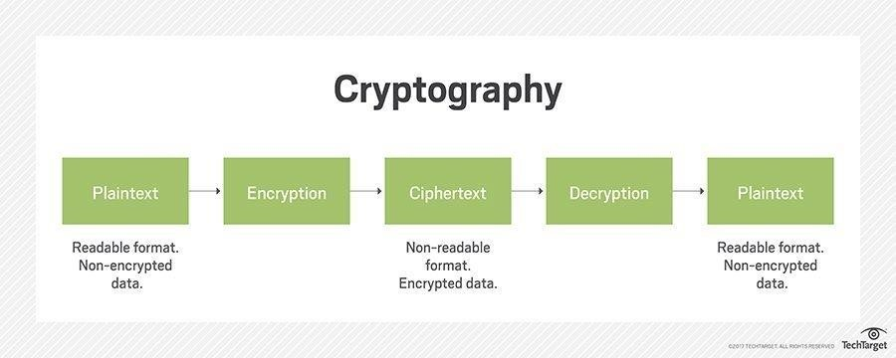
ARCHITECTURE

Slide 9
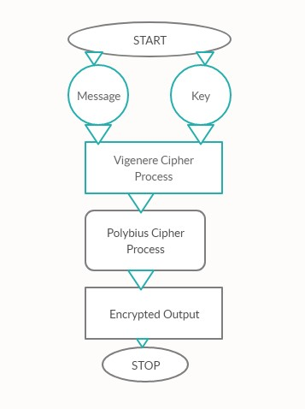
WORK FLOW

Slide 10
HARDWARE REQUIREMENTS
Processor : Intel-5 Processor
RAM : 4GB (min)
Hard Disk : 128 GB
Key Board : Normal
Mouse : Compatible Mouse

Slide 11
SOFTWARE REQUIREMENTS
Operating System : Windows 7 and Above.
Software : Python 3.6
Integrated Development Learning Environment : vs code
Integrated Development Environment : vs code

Slide 12
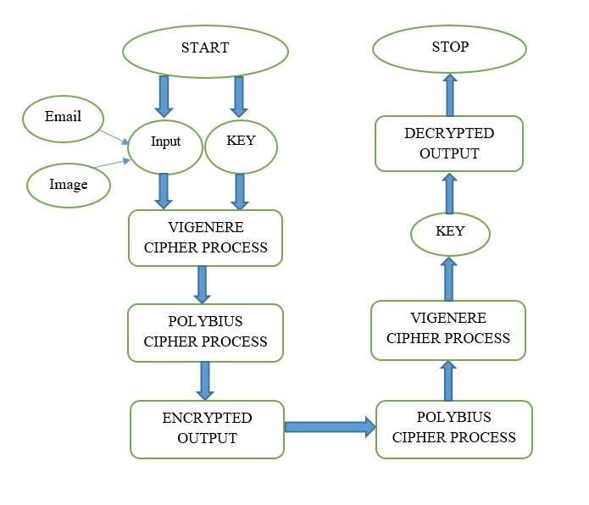
UML Diagrams
Use Case Diagram

Slide 13
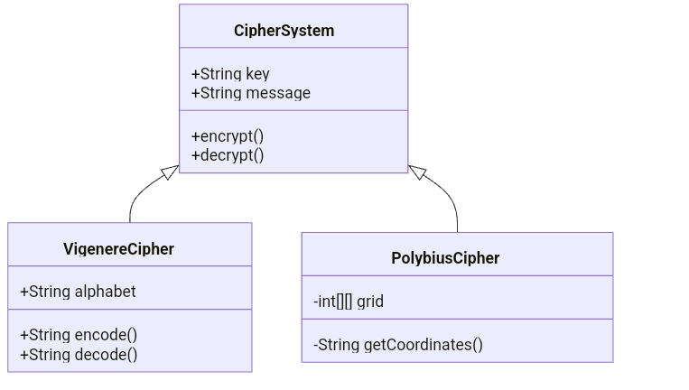
UML Diagrams
Class Diagram

Slide 14
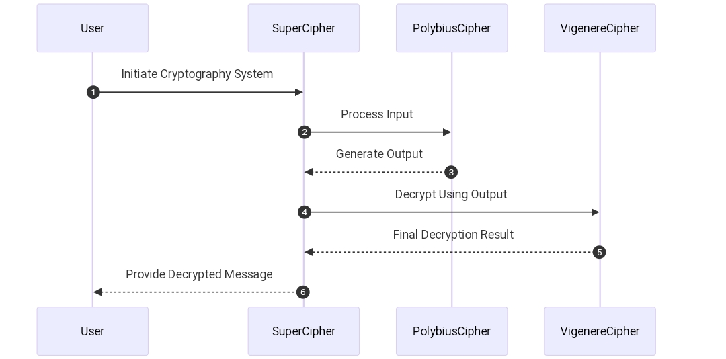
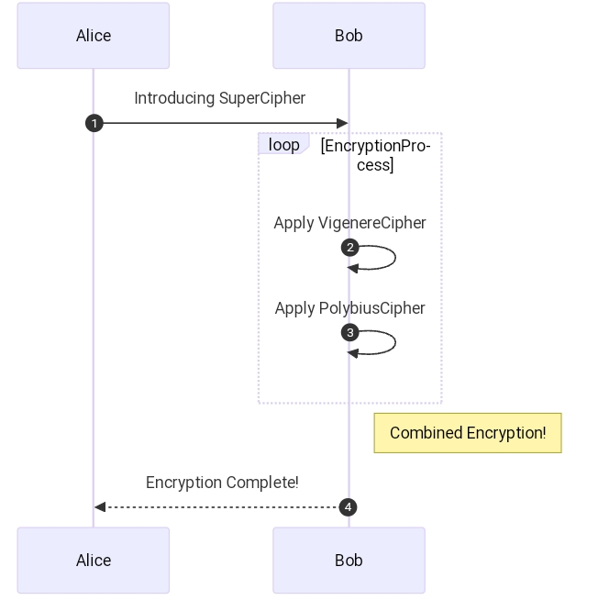
UML Diagrams
Sequence Diagram

Slide 15
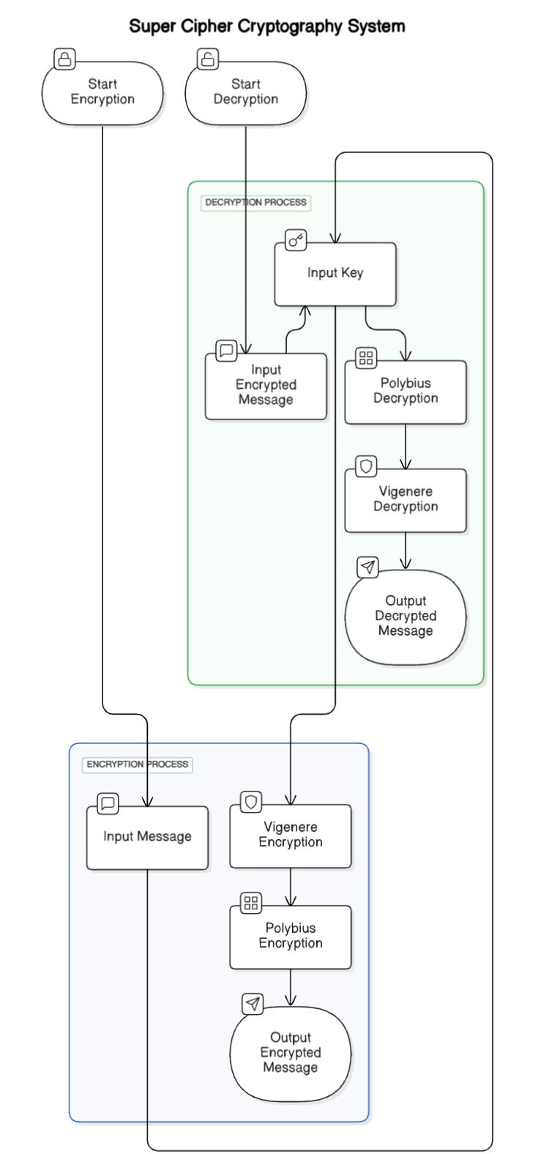
UML Diagrams
Activity Diagram

Slide 16
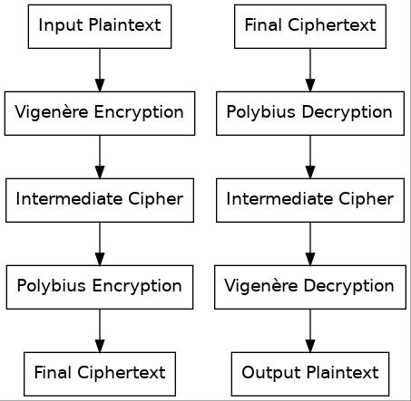
UML Diagrams
Collaboration Diagram

Slide 17
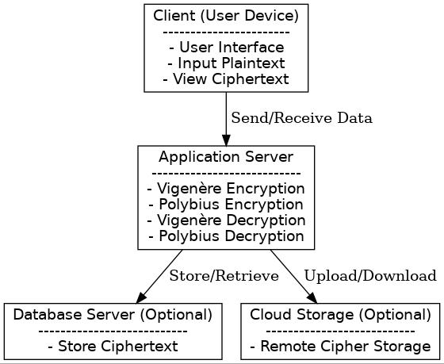
UML Diagrams
Deployment Diagram

Slide 18
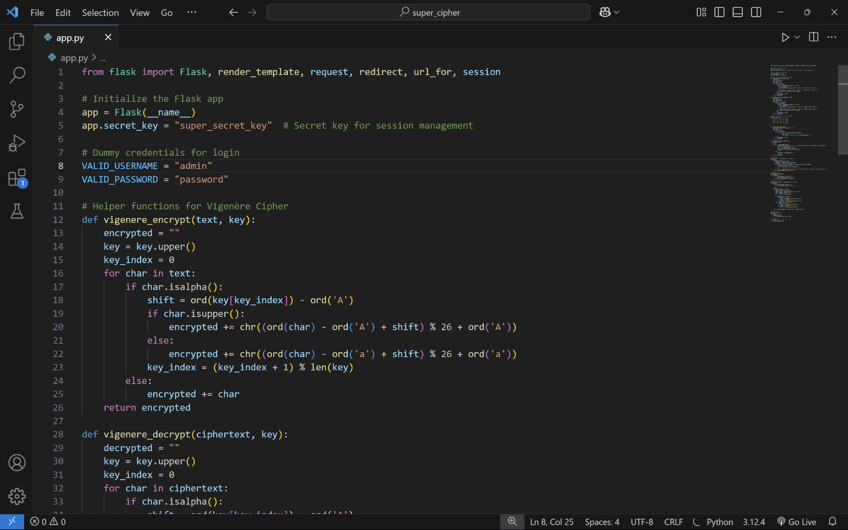
CODING

Slide 19
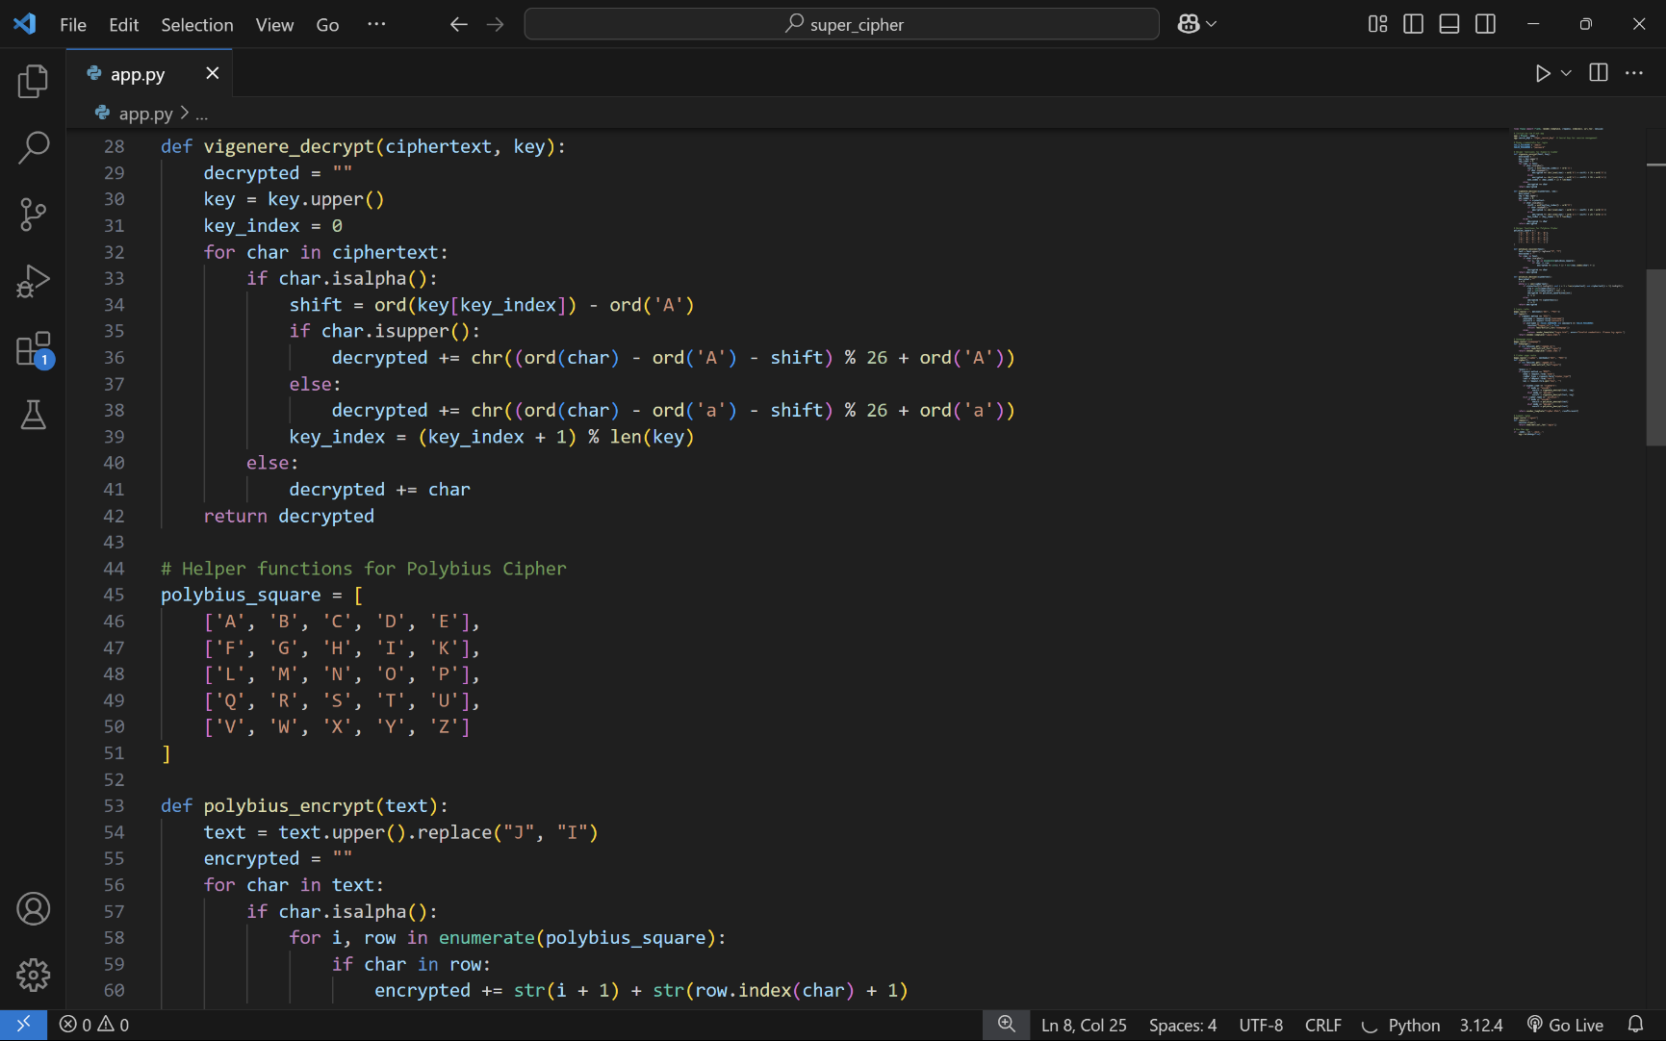
CODING

Slide 20
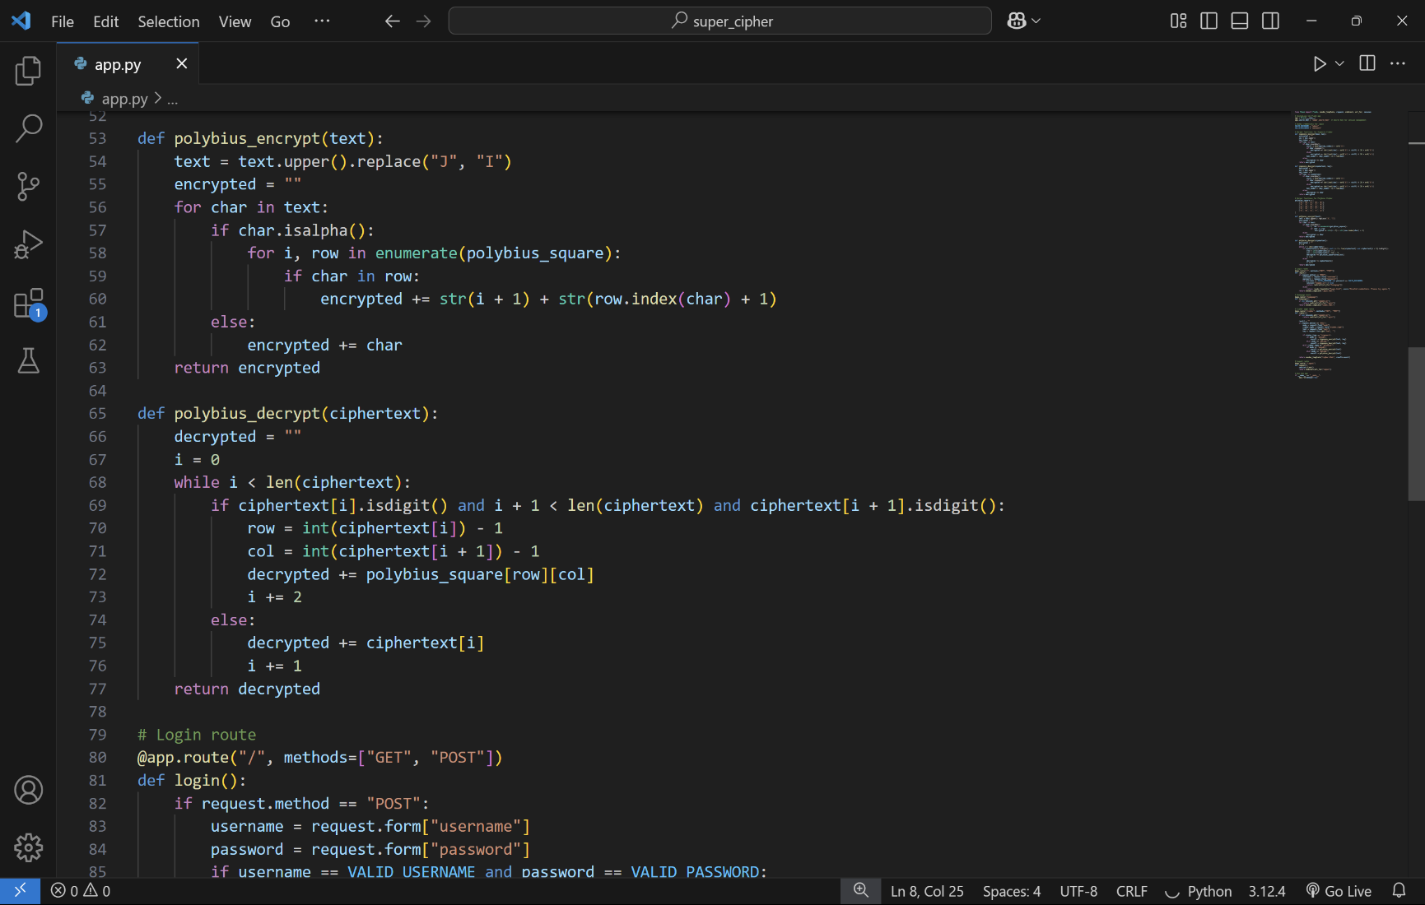
CODING

Slide 21
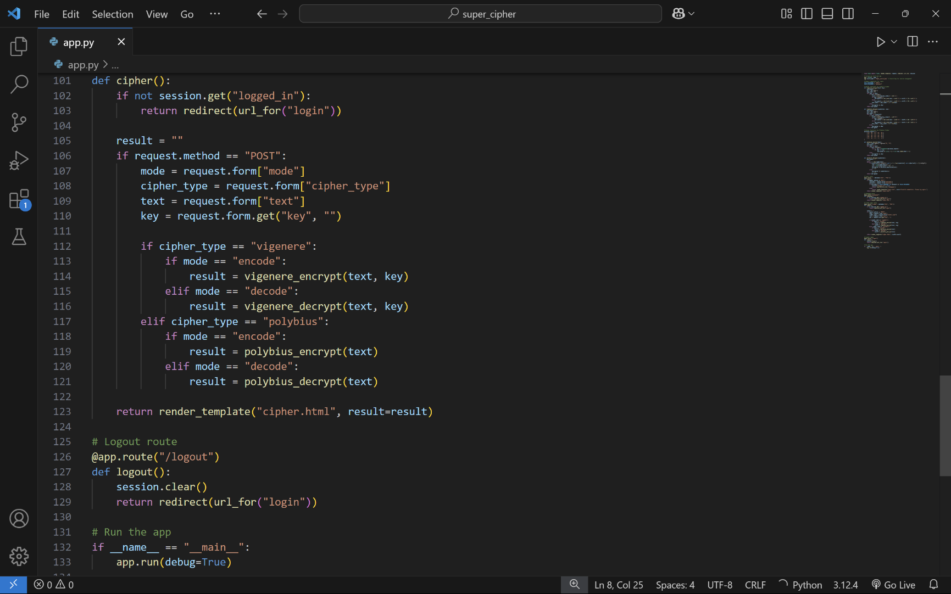
CODING

Slide 22
Conclusion
The combination of Vigenère and Polybius ciphers creates a layered encryption approach that demonstrates enhanced security over each individual cipher. The dual-layer system requires attackers to break both substitution methods, increasing the complexity of cryptanalysis.
While this hybrid approach offers valuable educational insights into classical cryptography principles, it remains vulnerable to modern cryptanalytic techniques. The system successfully achieves basic cryptographic requirements of being deterministic and reversible, while maintaining relatively simple implementation. However, like all classical ciphers, it should not be used for securing sensitive data in real-world applications.

